Slide 1
NoSQL systems:
sharding, replication and consistency

Slide 2
Data distribution
NoSQL systems: data distributed over large clusters
Data distribution models:
  Single server (is an option for some applications)
  Multiple servers
Types of data distribution:
  Sharding: different data on different nodes
  Replication: the same data copied over multiple nodes
CREDITS: Jimmy Lin (University of Maryland)

Slide 3



Replication
It comes in two forms:
master-slave
peer-to-peer
CREDITS: Jimmy Lin (University of Maryland)

Slide 4
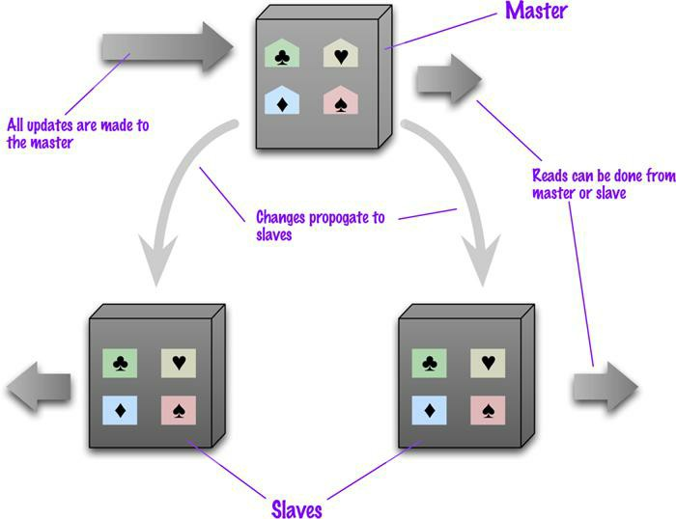
Master-Slave Replication
Master
  is the authoritative source for the data
  is responsible for processing any updates to that data
  can be appointed manually or automatically
Slaves
  A replication process synchronizes the slaves with the master
— After a failure of the master, a slave can be appointed as new master very quickly
CREDITS: Jimmy Lin (University of Maryland)

Slide 5
Pros and cons of Master-Slave Replication
Pros
  More read requests:
    Add more slave nodes
    Ensure that all read requests are routed to the slaves
  Should the master fail, the slaves can still handle read requests
Cons
  The master is a bottleneck
    Limited by its ability to process updates and to pass those updates on
    Its failure does eliminate the ability to handle writes until:
      the master is restored or
      a new master is appointed
  Inconsistency due to slow propagation of changes to the slaves
  Bad for datasets with heavy write traffic
CREDITS: Jimmy Lin (University of Maryland)

Slide 6
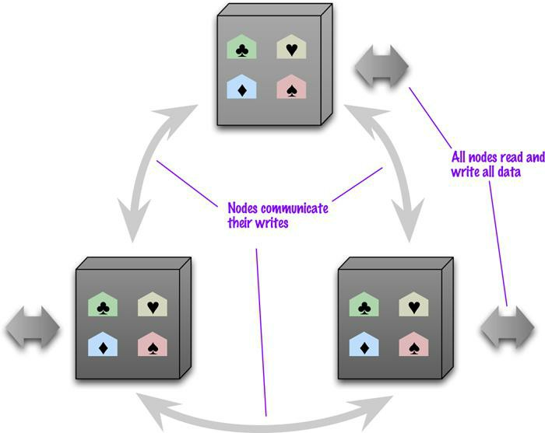
Peer-to-Peer Replication
All the replicas have equal weight, they can all accept writes
The loss of any of them doesn’t prevent access to the data store.
CREDITS: Jimmy Lin (University of Maryland)

Slide 7
Pros and cons of peer-to-peer replication
Pros:
  you can ride over node failures without losing access to data
  you can easily add nodes to improve your performance
Cons:
  Inconsistency!
    Slow propagation of changes to copies on different nodes
      Inconsistencies on read lead to problems but are relatively transient
    Two people can update different copies of the same record stored on different nodes at the same time - a write-write conflict.
      Inconsistent writes are forever.
CREDITS: Jimmy Lin (University of Maryland)

Slide 8

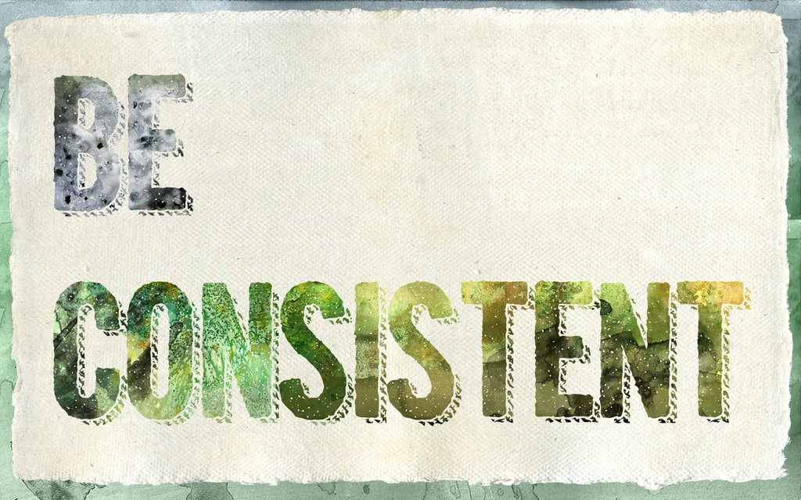
Consistency
Biggest change from a centralized relational database to a cluster- oriented NoSQL
  Relational databases: strong consistency
  NoSQL systems: mostly eventual consistency
CREDITS: Jimmy Lin (University of Maryland)

Slide 9
Conflicts
Read-read (or simply read) conflict:
  Different people see different data at the same time
  Stale data: out of date
Write-write conflict
  Two people updating the same data item at the same time
  If the server serialize them: one is applied and immediately overwritten by the other (lost update)
Read-write conflict:
  A read in the middle of two logically-related writes
CREDITS: Jimmy Lin (University of Maryland)

Slide 10
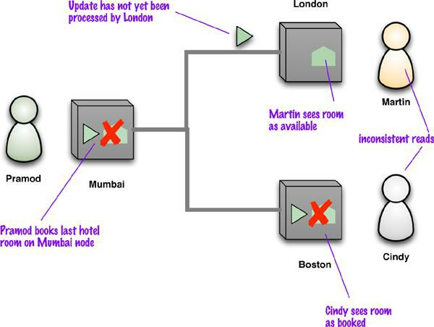
Read conflict
— Replication is a source of inconsistency
CREDITS: Jimmy Lin (University of Maryland)

Slide 11
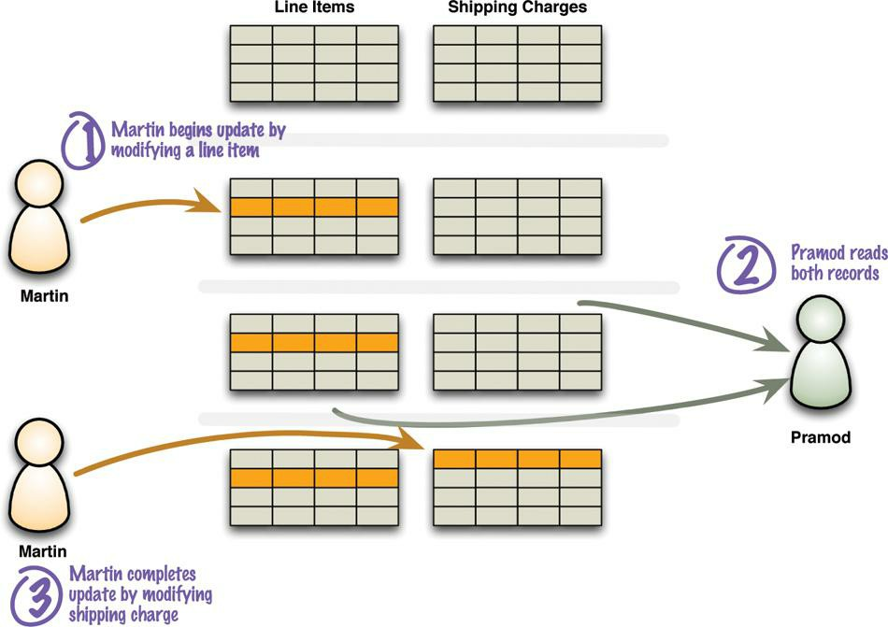
Read-write conflict
— A read in the middle of two logically-related writes
CREDITS: Jimmy Lin (University of Maryland)

